Slide 1
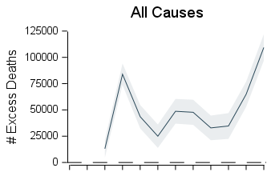
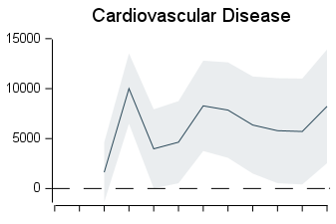
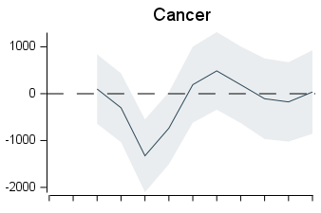
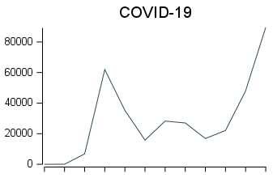
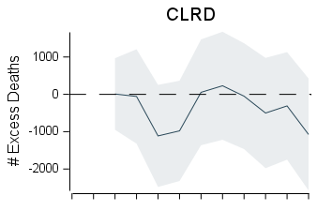
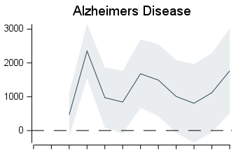
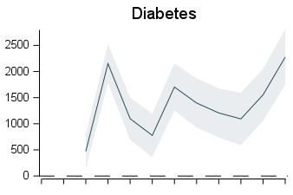
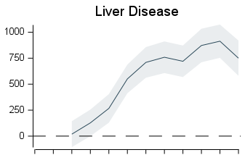
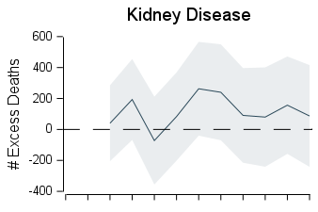
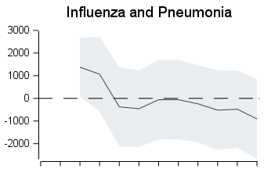
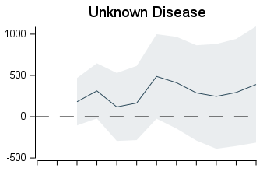
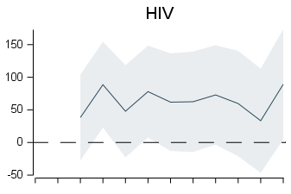
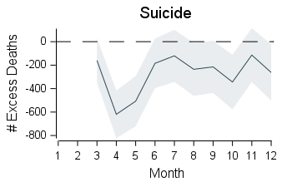
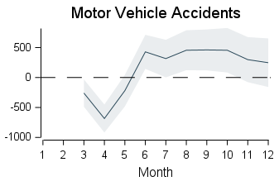
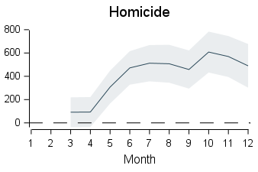
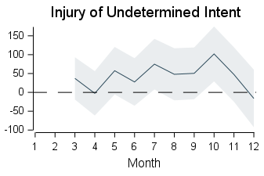
United States
Excess Deaths by Cause of Death

Slide 2
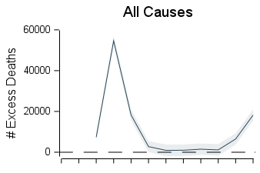
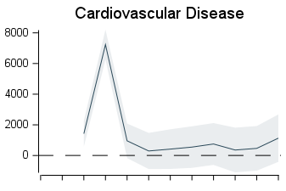
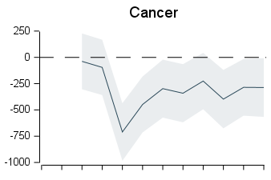
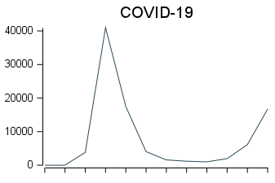
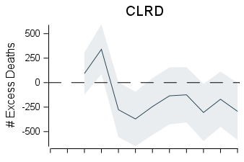
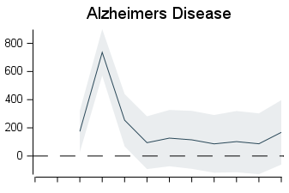
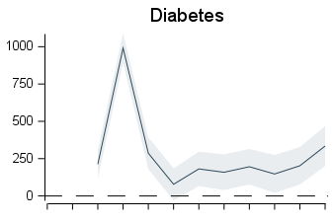
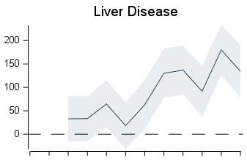
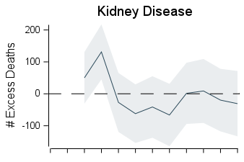
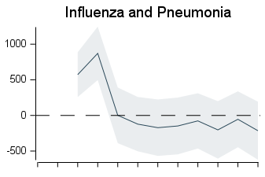
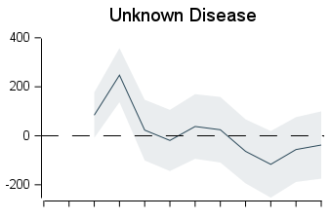
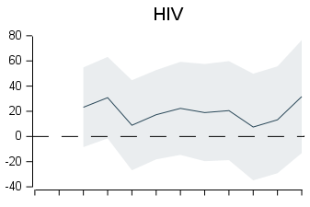
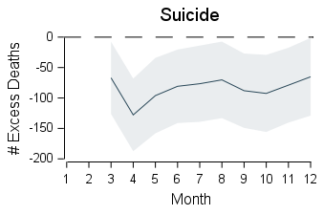
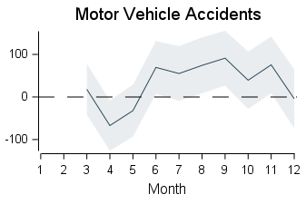
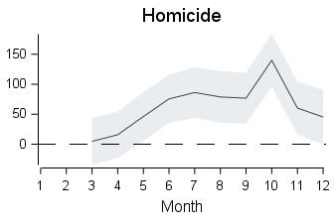
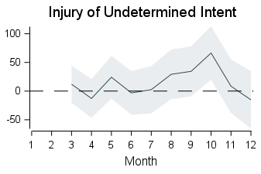
Mideast + New England
Excess Deaths by Cause of Death

Slide 3
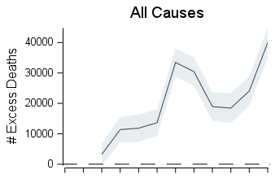
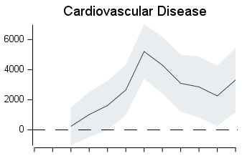
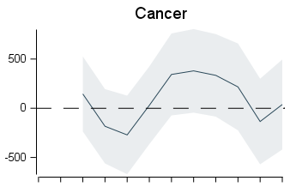
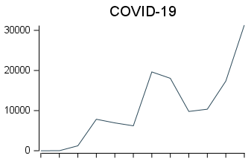
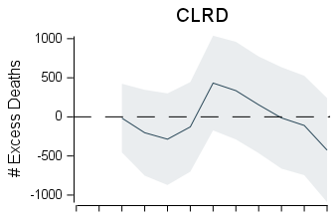
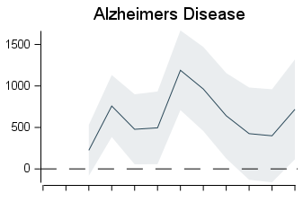
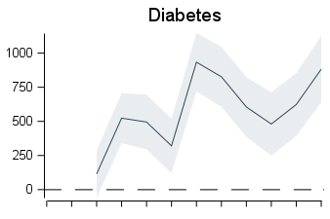
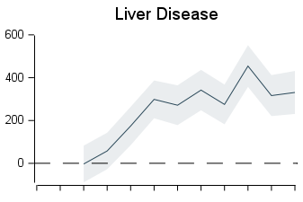
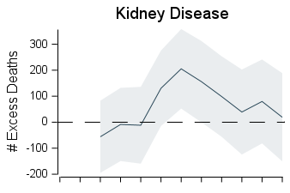
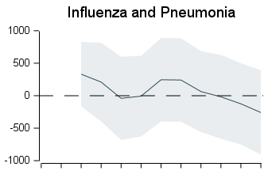
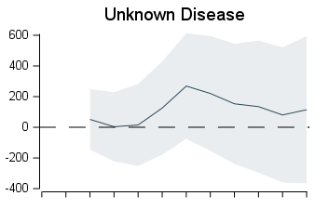
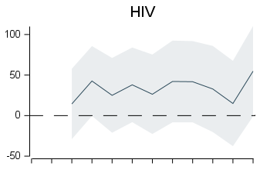
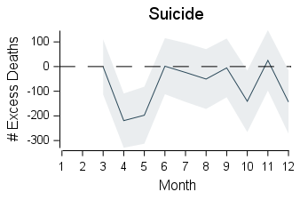
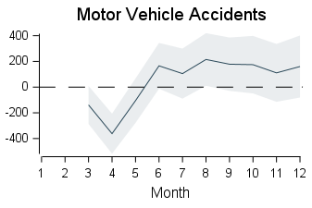
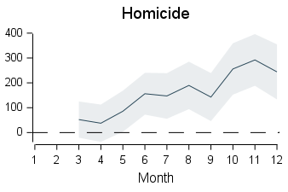
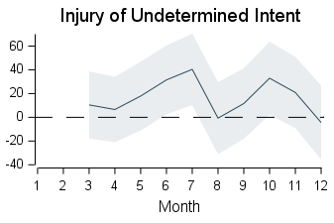
Southeast + Southwest
Excess Deaths by Cause of Death

Slide 4
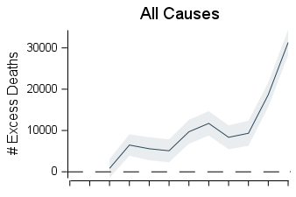
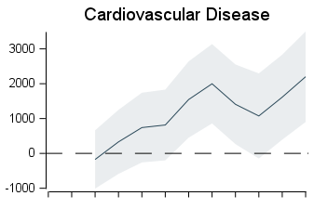














Far West + Plains + Rocky Mountain
Excess Deaths by Cause of Death

Slide 5
















Great Lakes
Excess Deaths by Cause of Death

Slide 6
















Alabama
Excess Deaths by Cause of Death

Slide 7
















Alaska
Excess Deaths by Cause of Death

Slide 8
















Arizona
Excess Deaths by Cause of Death

Slide 9
















Arkansas
Excess Deaths by Cause of Death

Slide 10
















California
Excess Deaths by Cause of Death

Slide 11
















Colorado
Excess Deaths by Cause of Death

Slide 12
















Connecticut
Excess Deaths by Cause of Death

Slide 13
















Delaware
Excess Deaths by Cause of Death

Slide 14
















District of Columbia
Excess Deaths by Cause of Death

Slide 15
















Florida
Excess Deaths by Cause of Death

Slide 16
















Georgia
Excess Deaths by Cause of Death

Slide 17
















Hawaii
Excess Deaths by Cause of Death

Slide 18
















Idaho
Excess Deaths by Cause of Death

Slide 19
















Illinois
Excess Deaths by Cause of Death

Slide 20
















Indiana
Excess Deaths by Cause of Death

Slide 21
















Iowa
Excess Deaths by Cause of Death

Slide 22
















Kansas
Excess Deaths by Cause of Death

Slide 23
















Kentucky
Excess Deaths by Cause of Death

Slide 24
















Louisiana
Excess Deaths by Cause of Death

Slide 25
















Maine
Excess Deaths by Cause of Death

Slide 26
















Maryland
Excess Deaths by Cause of Death

Slide 27
















Massachusetts
Excess Deaths by Cause of Death

Slide 28
















Michigan
Excess Deaths by Cause of Death

Slide 29
















Minnesota
Excess Deaths by Cause of Death

Slide 30
















Mississippi
Excess Deaths by Cause of Death

Slide 31
















Missouri
Excess Deaths by Cause of Death

Slide 32
















Montana
Excess Deaths by Cause of Death

Slide 33
















Nebraska
Excess Deaths by Cause of Death

Slide 34
















Nevada
Excess Deaths by Cause of Death

Slide 35
















New Hampshire
Excess Deaths by Cause of Death

Slide 36
















New Jersey
Excess Deaths by Cause of Death

Slide 37
















New Mexico
Excess Deaths by Cause of Death

Slide 38
















New York
Excess Deaths by Cause of Death

Slide 39
















North Carolina
Excess Deaths by Cause of Death

Slide 40
















North Dakota
Excess Deaths by Cause of Death

Slide 41
















Ohio
Excess Deaths by Cause of Death

Slide 42
















Oklahoma
Excess Deaths by Cause of Death

Slide 43
















Oregon
Excess Deaths by Cause of Death

Slide 44
















Pennsylvania
Excess Deaths by Cause of Death

Slide 45
















Rhode Island
Excess Deaths by Cause of Death

Slide 46
















South Carolina
Excess Deaths by Cause of Death

Slide 47
















South Dakota
Excess Deaths by Cause of Death

Slide 48
















Tennessee
Excess Deaths by Cause of Death

Slide 49
















Texas
Excess Deaths by Cause of Death

Slide 50
















Utah
Excess Deaths by Cause of Death

Slide 51
















Vermont
Excess Deaths by Cause of Death

Slide 52
















Virginia
Excess Deaths by Cause of Death

Slide 53
















Washington
Excess Deaths by Cause of Death

Slide 54
















West Virginia
Excess Deaths by Cause of Death

Slide 55
















Wisconsin
Excess Deaths by Cause of Death

Slide 56
















Wyoming
Excess Deaths by Cause of Death

